Slide 1
Reinforcement Learning PPO GRPO DAPO
Name：Hongbo Wang
25-04-14

Slide 2
Contents
Basic Concepts
PPO
GRPO
DAPO

Slide 3
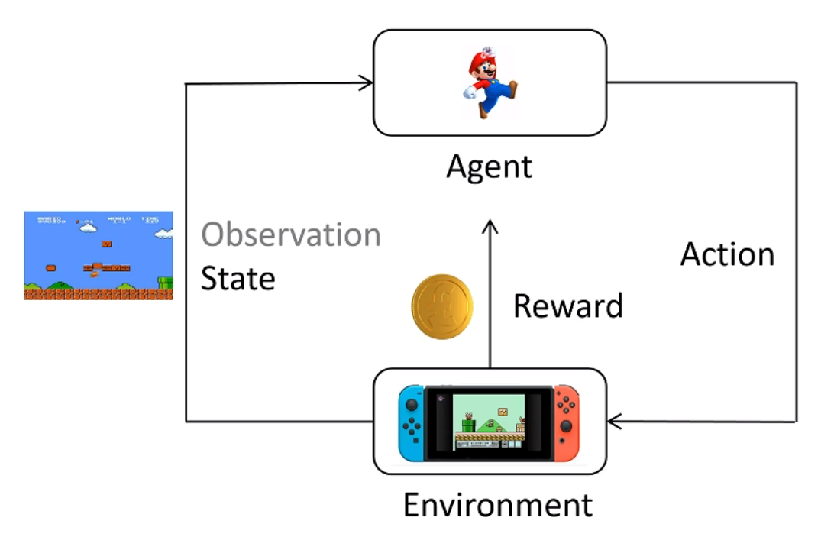
Basic Concepts
Agent: Agent, adopts a policy
State: Current state
Action: Action
Policy: Policy Π, the probability of taking each action
Reward: Reward
Trajectory: Multi-step trajectory
Return: Cumulative reward of the trajectory
The goal of reinforcement learning is to train a policy that maximizes the expected return over all possible trajectories, i.e., to maximize the average return across the entire path.

Slide 4
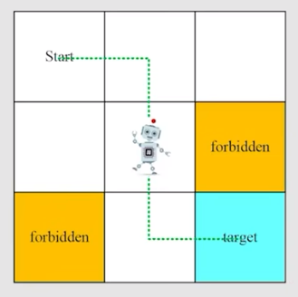
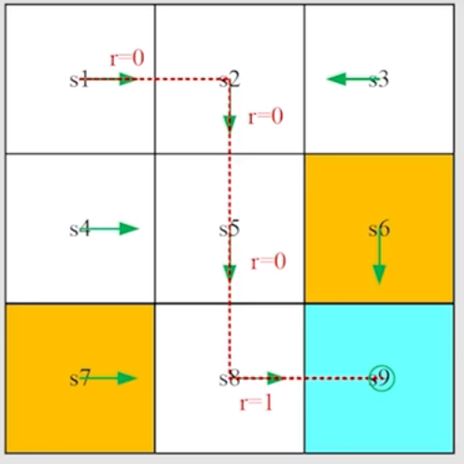
Basic Concepts
Agent: LLM
State: Current output token state
Action: Output token
Policy: Policy Π, how to select the output token
Reward: reward model
Trajectory: Complete output sentence
The goal of reinforcement learning is to train a policy that maximizes the expected return over all possible trajectories, i.e., to maximize the average return across the entire path.

Slide 5
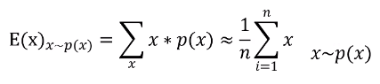
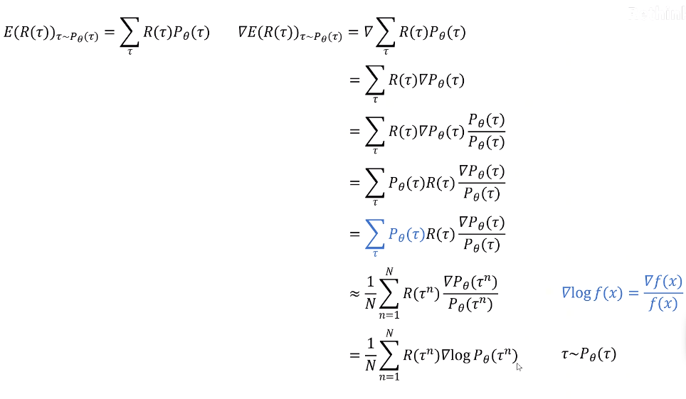
Basic Concepts
Expected Value Calculation Formula
Expectation Maximization Derivation
1
2
3
4
5

Slide 6
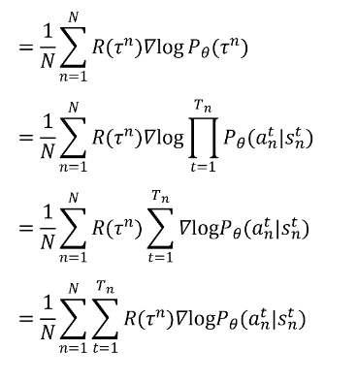
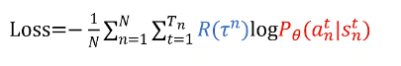
Basic Concepts
Expectation Maximization Derivation
5
6
Common Forms of Loss Functions

Slide 7
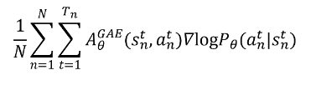
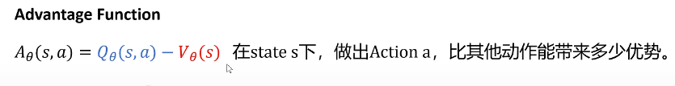
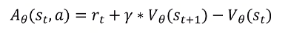
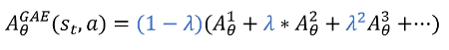
PPO
Replace with Advantage Function

Slide 8
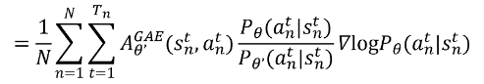
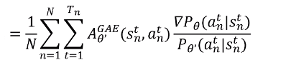
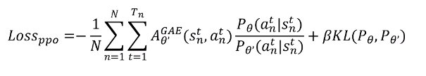
PPO
Add Reference Policy
Off policy

Slide 9
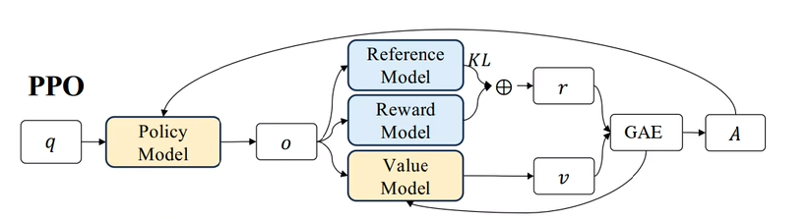
PPO

Slide 10
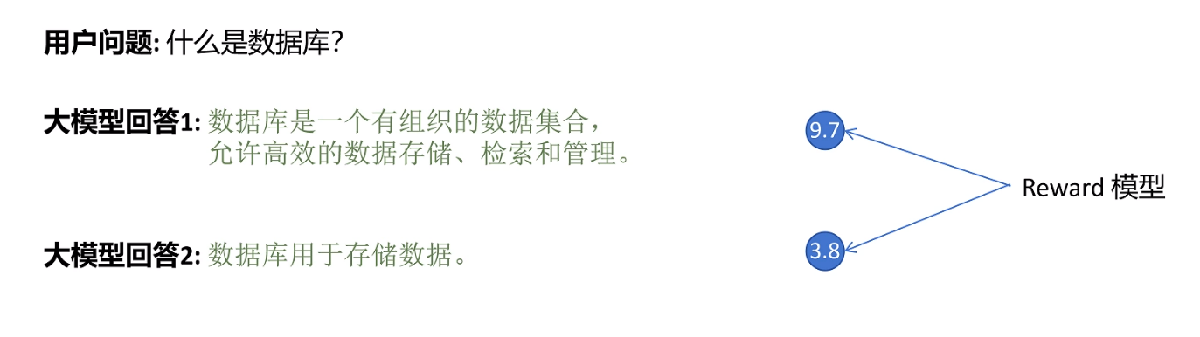
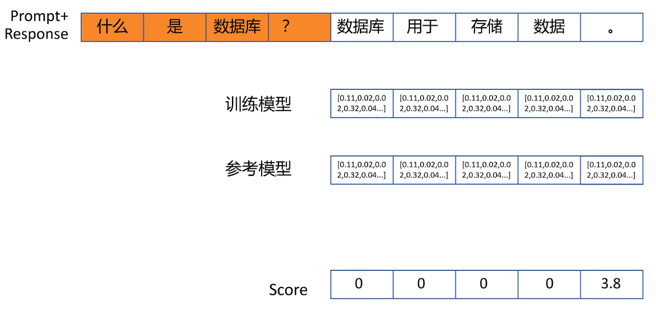
Limitation of PPO
Q
Reward Score1
A1
Reward Score2
A2
Policy model
In the reward model, a sentence outputs a reward value, and the previous values are all 0. Using 0 to calculate the advantage function does not make much sense.
Reference model

Slide 11
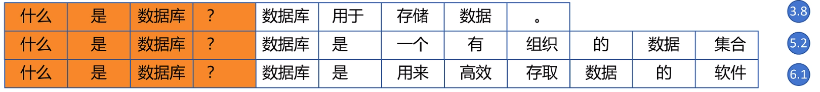
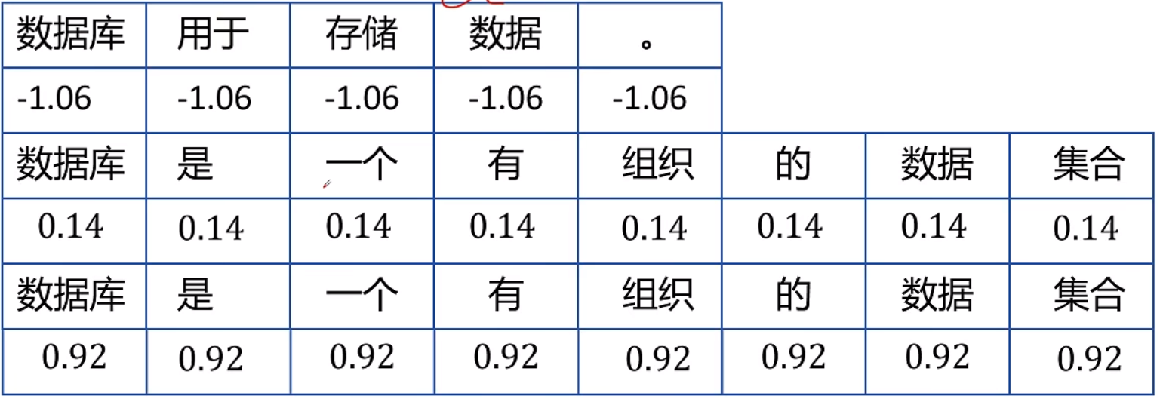
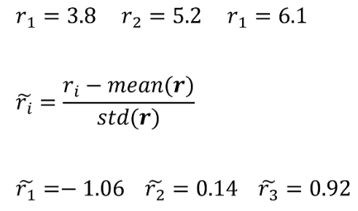
GRPO Group-relative Policy Optimization
PPO
GRPO
Compared to PPO, GRPO no longer requires using the entire action; it only uses the reward to calculate the advantage function, and no longer needs a value model.

Slide 12
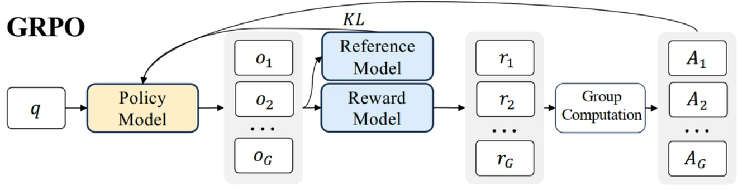
GRPO Group-relative Policy Optimization
GRPO can calculate the advantage function without the need for a value model.

Slide 13
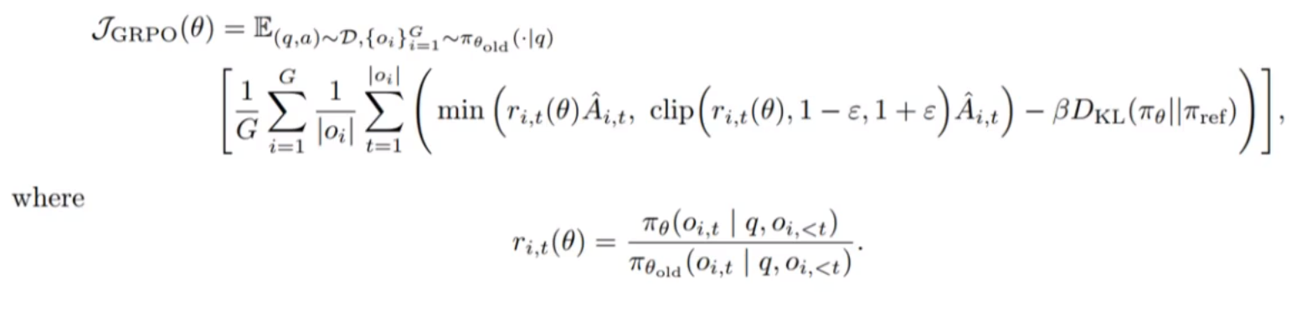
GRPO Group-relative Policy Optimization
Standard Formula in Papers

Slide 14
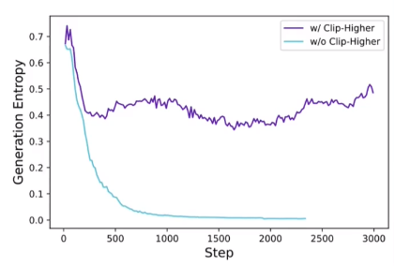
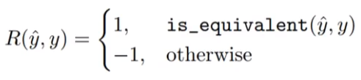
Limitation of GRPO Introdution to DAPO
1.The entropy decreases too quickly, leading to rapid convergence and entropy collapse, which causes many parameters to remain suboptimal — set a higher Clip ε_{high}
2.Dynamic Sampling -- In the group response for reward sampling, all correct = all incorrect
1
1
Delete Sample
1
3.Imbalanced reward for long and short sentences -- Token-level optimization

Slide 15
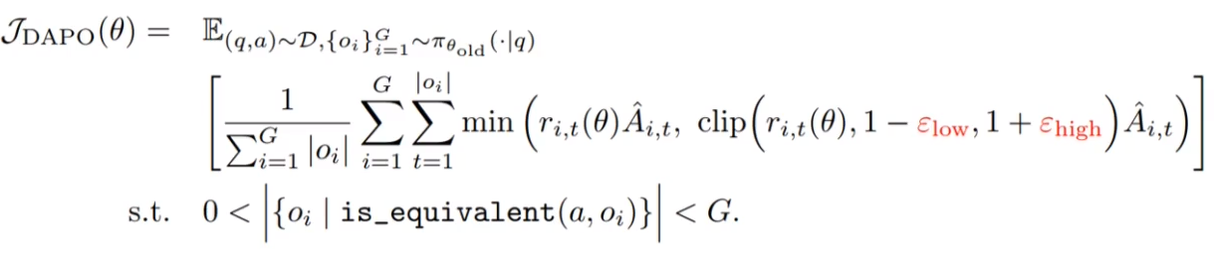
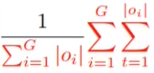
DAPO (Decoupled Clip and Dynamic Sampling Policy Optimization）
1.The entropy decreases too quickly, leading to rapid convergence and entropy collapse, which causes many parameters to remain suboptimal — set a higher Clip ε_{high}
2.Dynamic Sampling -- In the group response for reward sampling, all correct = all incorrect
3.Imbalanced reward for long and short sentences -- Token-level optimization
3
1
2

Slide 16
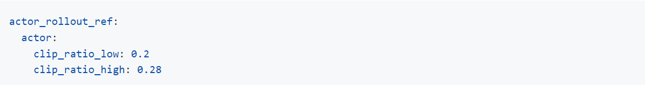
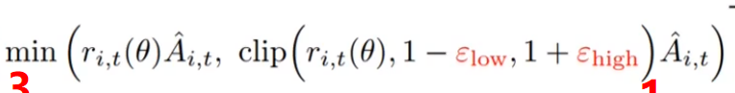
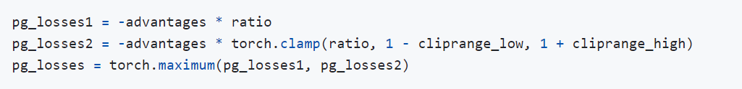
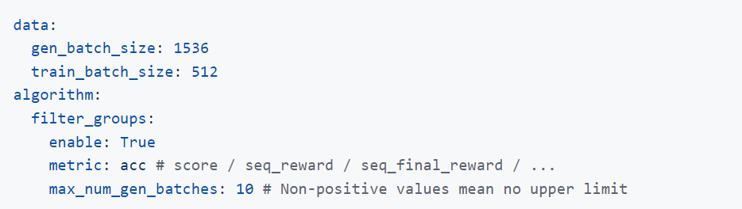
DAPO (Decoupled Clip and Dynamic Sampling Policy Optimization）

Slide 17
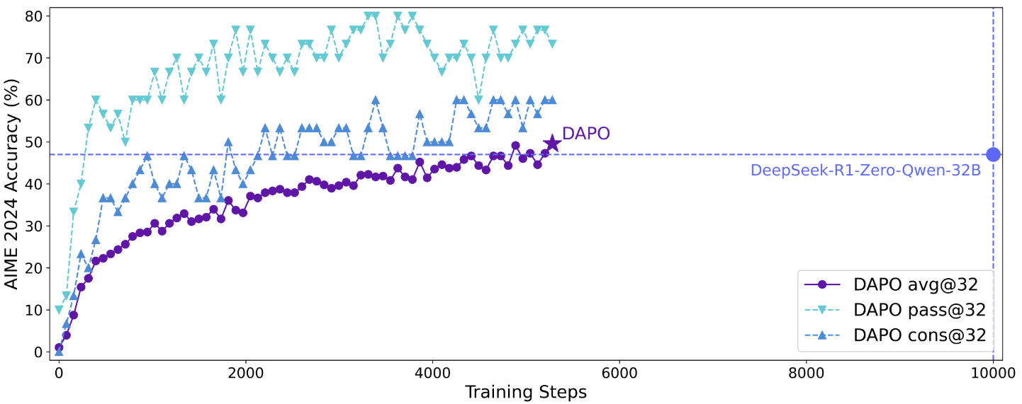
DAPO (Decoupled Clip and Dynamic Sampling Policy Optimization）
In terms of inference performance, DAPO outperforms the GRPO framework's Deepseek-R1-Qwen-32B, with a 50% reduction in resources.

Slide 18
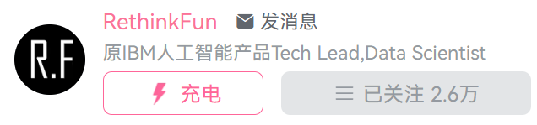
Reference
零基础学习强化学习算法：ppo
https://www.bilibili.com/video/BV1iz421h7gb/?spm_id_from=333.1391.0.0&vd_source=6374cb49b8a20f29e86ab9de12471afa
代码实现大模型强化学习(PPO)，看这个视频就够了https://www.bilibili.com/video/BV1rixye7ET6?spm_id_from=333.788.videopod.sections&vd_source=6374cb49b8a20f29e86ab9de12471afa
DeepSeek-GRPO
hhttps://www.bilibili.com/video/BV1enQLYKEA5/?spm_id_from=333.1391.0.0&vd_source=6374cb49b8a20f29e86ab9de12471afa
[文章解读]字节跳动与清华发布强化学习新算法DAPO，性能超越DeepSeek-R1(GRPO)
https://www.bilibili.com/video/BV1gmXFYxEKT/?spm_id_from=333.1391.0.0&vd_source=6374cb49b8a20f29e86ab9de12471afa

Slide 19
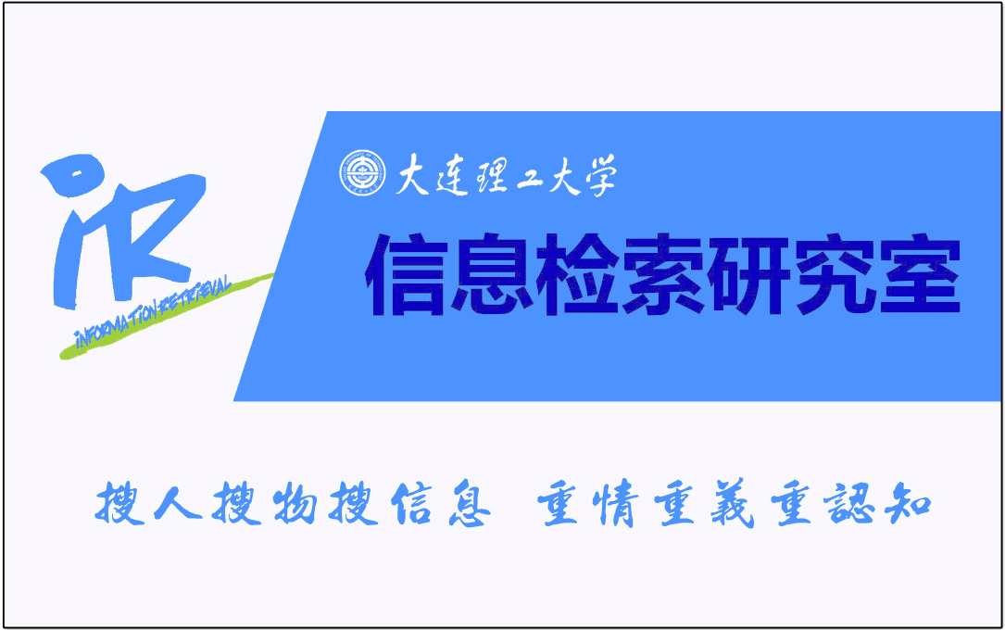
Thanks！
http://ir.dlut.edu.cn

